Slide 1
Customer Segmentation Using RFM Analysis and K-Means
KPMG Data Analytics consultant Virtual Internship
Gawtam Bhat
Contact: infinitebhat@gmail.com

Slide 2
Agenda
Introduction.
Data Exploration.
Model Development.
Results and Interpretation.
Dashboard of recommendation.

Slide 3
Why I chose RFM Analysis project to present today?
Demand forecasts are essential for managing supply chain activities but are difficult to create when collaborative information is absent.
Many traditional and advanced forecasting tools are available but applying them to a large number of customers is not ALWAYS ACCURATE.
If you can identify segments of customers with similar demand behaviors, Historical usage can be used to cluster customers with similar demands.
Once customer segments are identified, a manageable number of forecasting models can be built to represent the customers within the segments.
This presentation results are developed using MS Excel and Python for clustering using K-Means.
Tableau and Excel were used for Visualization.
Notes:
Demand forecasts are essential for managing supply chain activities but are difficult to create when collaborative information is absent.
Many traditional and advanced forecasting tools are available but applying them to a large number of customers is not manageable.
If you can identify segments of customers with similar demand behaviors. Historical usage can be used to cluster customers with similar demands. Once customer segments are identified, a manageable number of forecasting models can be built to represent the customers within the segments.

Slide 4
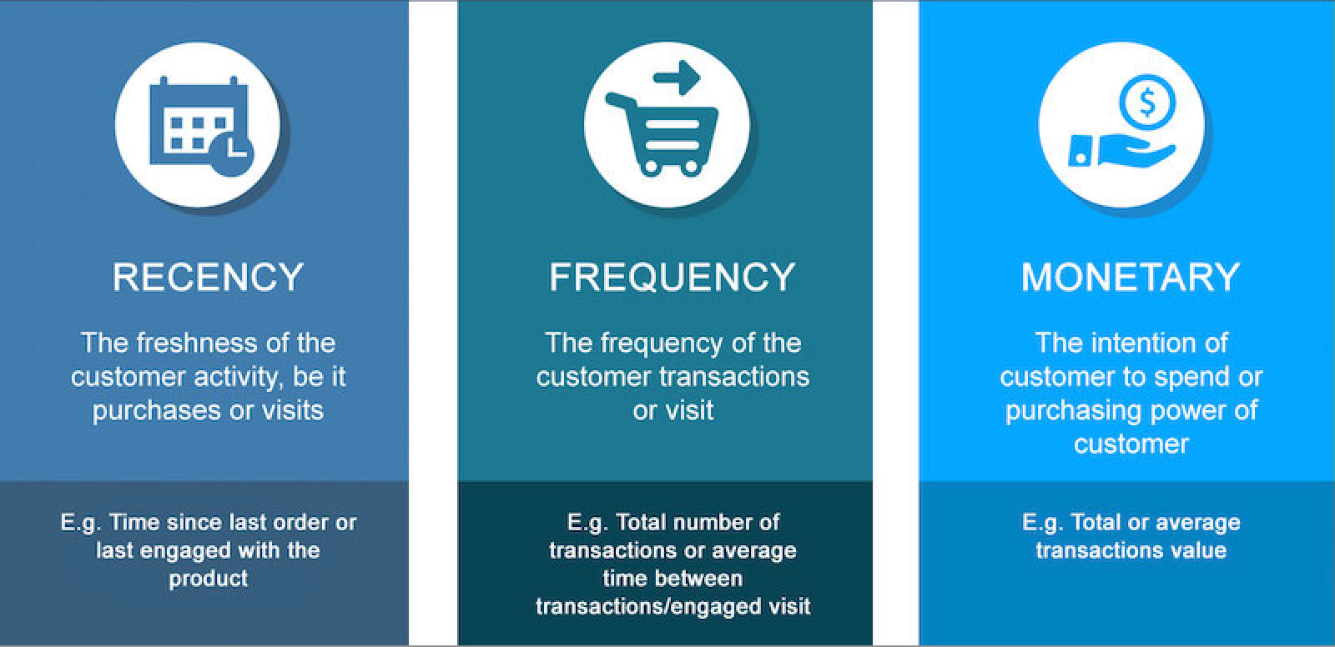

RFM Metrics

Slide 5
Aim of the Project and Problem Statement
Aim is to Identify and Recommend Top 1000 customers to introduce new products as well as to increase its sale on its existing catalog.
Sprocket Central, a company that specializes in high quality bikes and accessible cycling accessories to riders.
Marketing team looking to analyze given 3 dataset and boost business and sales by targeting right customers.
Using 3 datasets provided, the aim is to analyze and recommend 1000 customers that Sprocket Central should target to drive the sales.

Slide 6
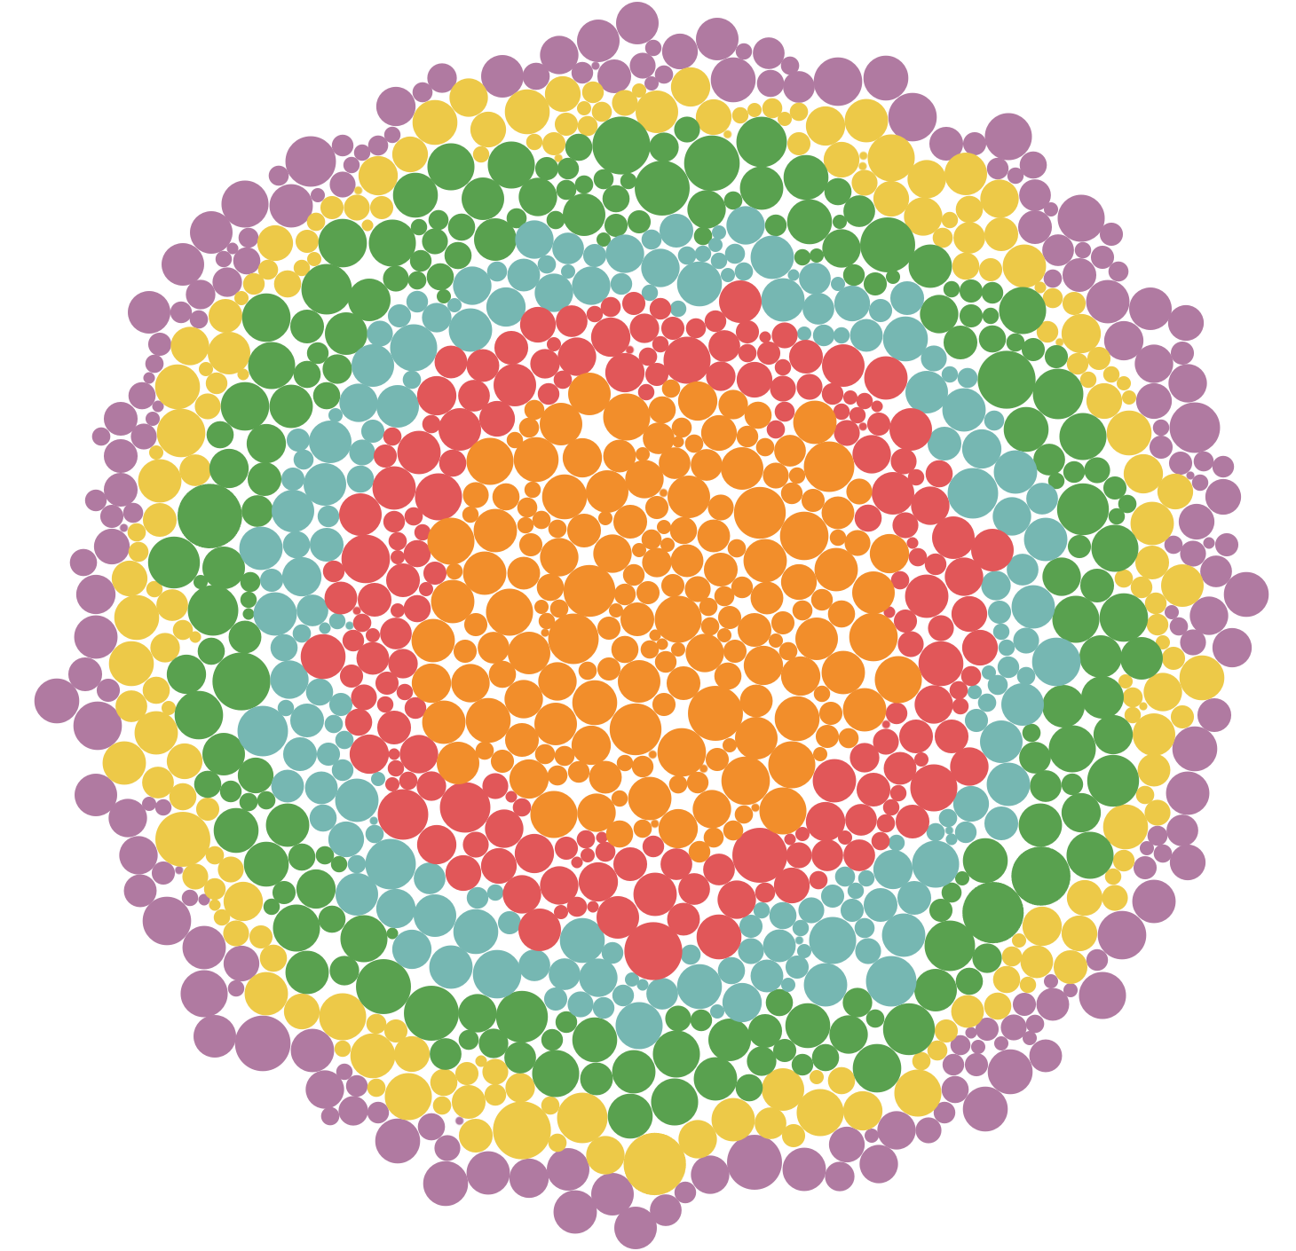
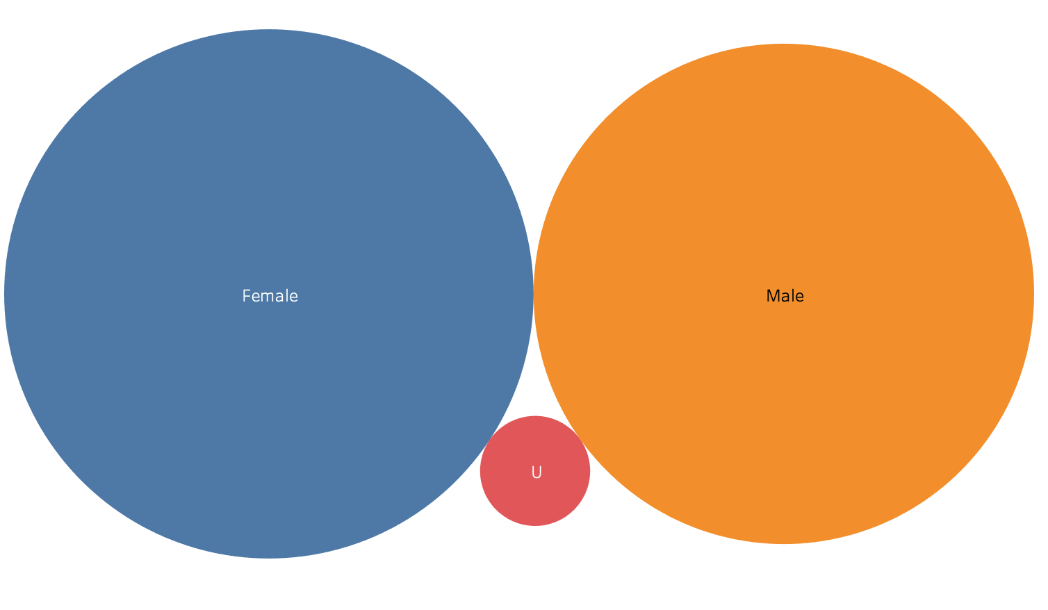
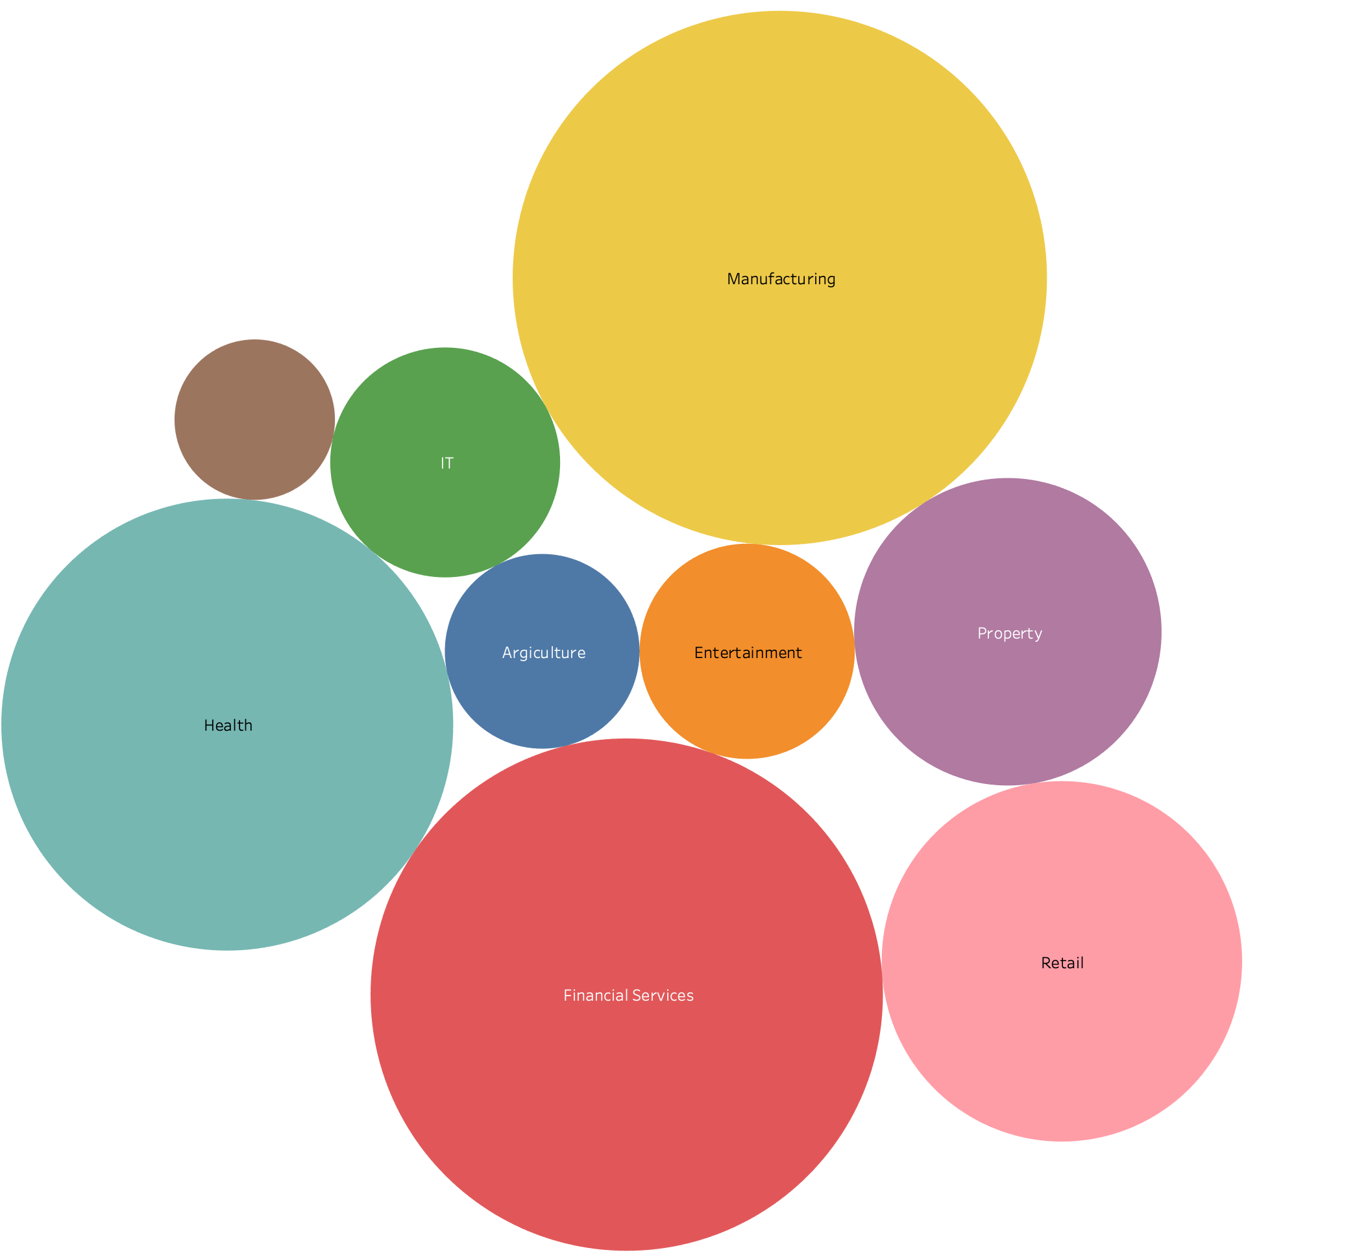
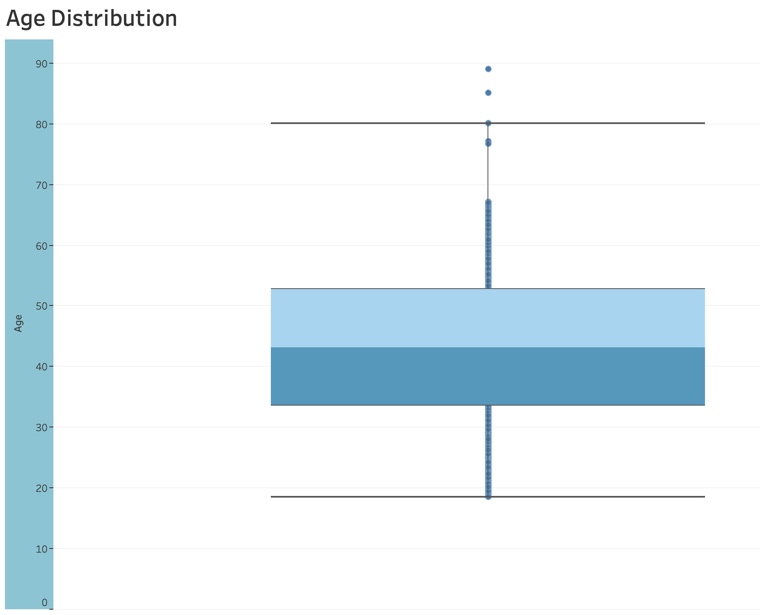
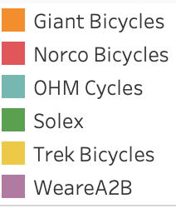
What data tells about customers?

Slide 7
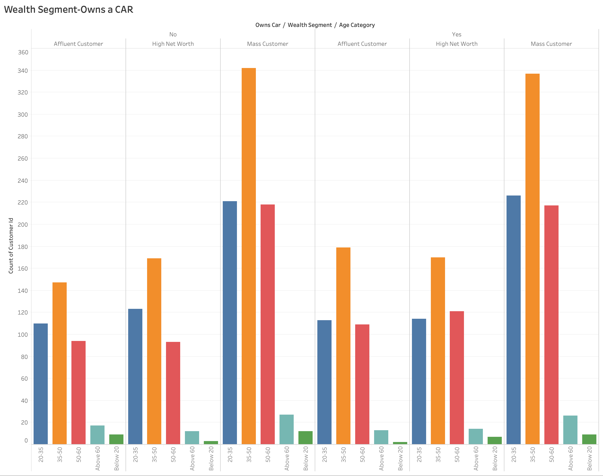
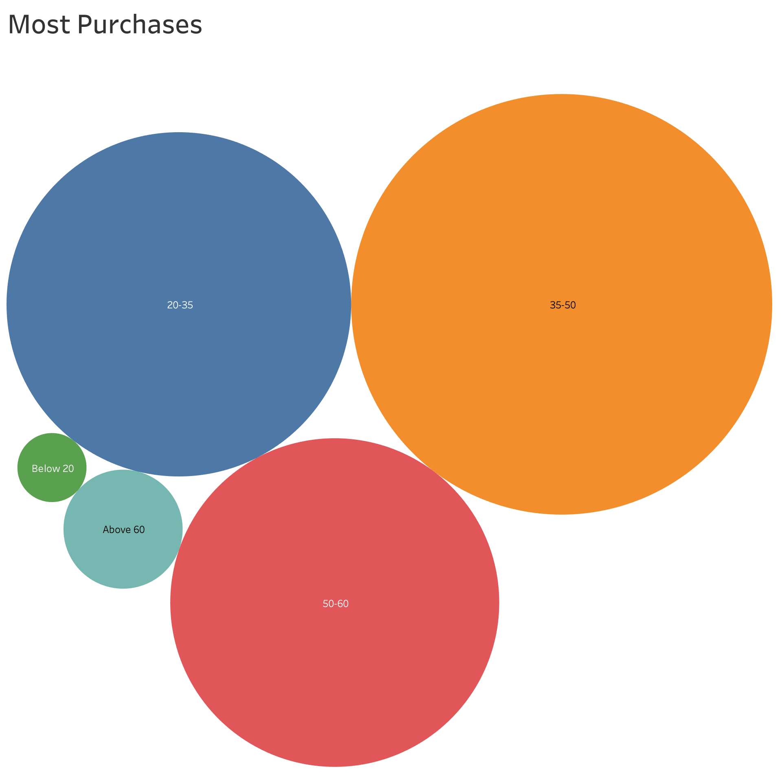
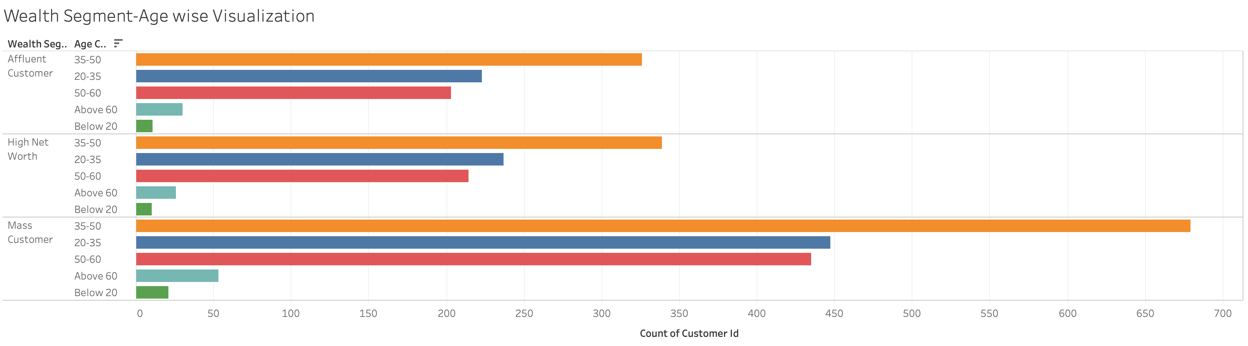
What data tells about customers?

Slide 8
Model Development- Data Mining and Cleaning
Picking the data points that need to be analyzed.
Finding anomaly in data and filter out.
Extracting the relevant information from the data.
Identifying the key values from the extracted data set.
Interpreting and reporting the results.
Notes:
RFM segmentation is a great method to identify groups of customers for special treatment.
RFM segmentation allows marketers to target specific clusters of customers with communications that are much more relevant for their particular behavior – and thus generate much higher rates of response, plus increased loyalty and customer lifetime value.

Slide 9
Model Development-RFM Analysis
First calculate and assign the Recency, Frequency and Monetary values to each customer.
Then use K-means classification to clustering.
Divide customer list to tiered groups using Recency, Frequency and Monetary Values.
Assign customer groups by manual clustering using the tiered groups which we created.
Final step is to craft the personalized marketing tailored to each customer group.
OR
Notes:
RFM segmentation is a great method to identify groups of customers for special treatment.
RFM segmentation allows marketers to target specific clusters of customers with communications that are much more relevant for their particular behavior – and thus generate much higher rates of response, plus increased loyalty and customer lifetime value.

Slide 10
Model Development : Clustering the customers
Champions:
Loyalists:
At-Risk Customers:
Bought recently, buy often and spend the most!
New Customers:
Spend good money with us often. Responsive to promotions.
Bought most recently, but recent frequency and monetary value is higher.
Can't Loose them:
Spent big money and purchased often. But long time ago. Need to bring them back!
Lost Customers:
Made biggest purchases. But haven’t returned for a long time.
Lowest recency, frequency and monetary scores.

Slide 11
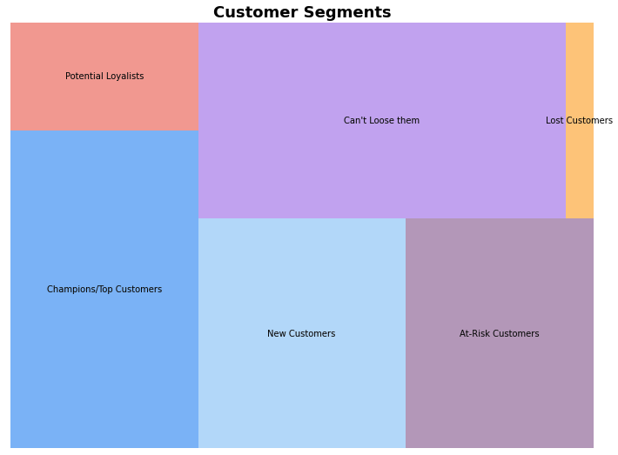
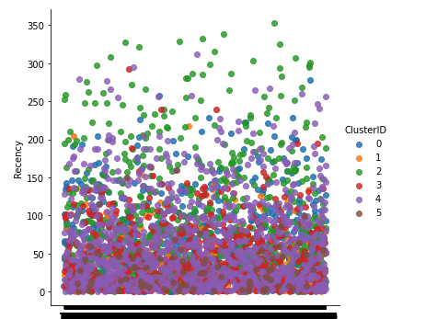
Results and Interpretation

Slide 12
Customer Category to Target
Now, since our customer Sprocket Ltd. has asked us to find 1000 its best customers to promote new products as well as to increase its sale on its existing catalog, We recommend based on following factors:
Potential 1000 are Sprockets top customers based on Frequency, Recency and Monetary Values.
The Minimum Monetary value of each of the customer we recommended are 2000$.
The Frequency in last 3 years is 6 times or more, which is an average purchase for every two months.
The recency is 90 days or fewer which means the last purchase was within last 3 months.

Slide 13
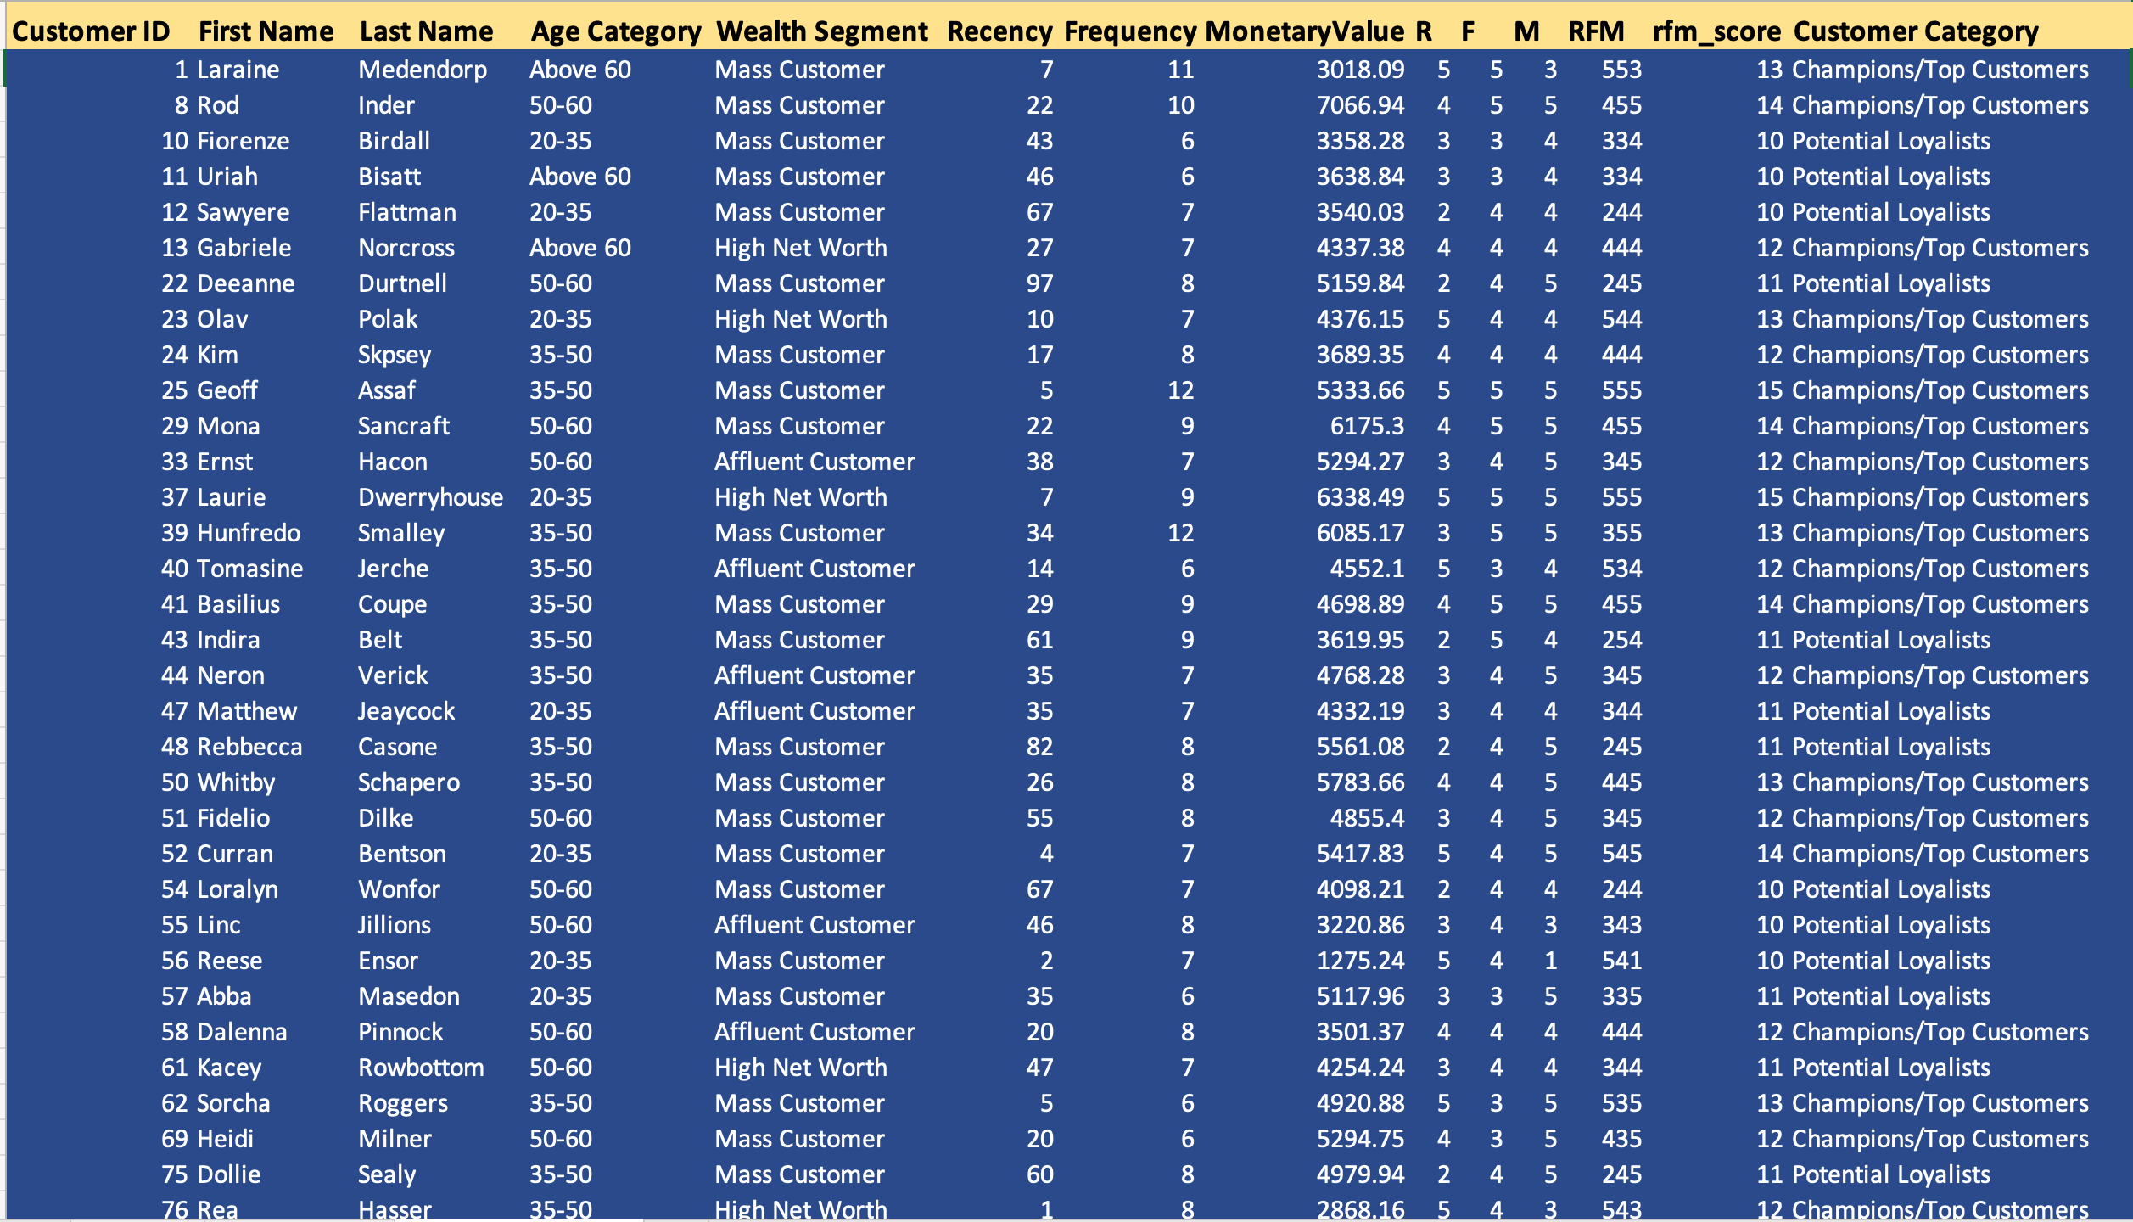

Slide 14
Time for your questions!
Thank You
Gawtam Bhat
Contact: infinitebhat@gmail.com
Github link: https://github.com/infinitebhat

